Slide 1

Tranexamic acid for the treatment of gastrointestinal bleeding: an international randomised, double-blind placebo controlled trial

Slide 2
Previous evidence on TXA in GI bleeding - Death

Slide 3
Previous evidence on TXA in GI bleeding - Thromboembolic events
TXA
Placebo
Risk Ratio (95% CI)
Events
Total
Events
Total
Engquist 1979
5
102
2
102
Barer 1983
5
256
2
260
von Holstein 1987
1
164
2
164
Total
11
522
6
526
1.86 (0.66, 5.24)
0.02
0.1
1
10
50
Favours TXA
Favours placebo

Slide 4
Overview
ELIGIBILITY
Adults with significant acute upper or lower gastrointestinal bleeding
Responsible clinician is substantially uncertain as to the appropriateness of tranexamic acid in a patient
Appropriate CONSENT PROCESS (ie patient, representative or waiver)
RANDOMISE (tranexamic acid or placebo)
All clinically indicated treatment is given in addition to trial enrolment.
LOADING DOSE 1g TXA over 10 minutes
MAINTENANCE DOSE 3 g TXA over 24 hours
Complete OUTCOME FORM at discharge, death or day 28

Slide 5
HALT-IT trial recruitment
12,009 GI bleeding patients randomised from 164 hospitals
in 15 countries
First patient: 04/07/2013
Last patient: 21/06/2019

Slide 6
Trial recruitment by country

Slide 7
Trial profile
12,009 randomised
5,994 allocated TXA
6,015 allocated placebo
5,994 baseline data
6,015 baseline data
5,964 received loading dose
5,483 received maintenance dose
5,988 received loading dose
5,510 received maintenance dose
11 consent withdrawn
6 outcome data unavailable
18 consent withdrawn
11 outcome data unavailable
3 lost to follow-up
0 lost to follow-up
5,985 with outcome data
5,956 received allocated treatment
6,004 with outcome data
5,981 received allocated treatment

Slide 8
Baseline characteristics
 | TXA (N=5994) |  | Placebo (N=6015) | Placebo (N=6015)
 | n | % | n | n | %
Age at randomisation (years)
Mean (SD) | 58.1 | (17.0) | 58.1 |  | (17.0)
<40 | 790 | (13) | 779 |  | (13)
40-59 | 2355 | (39) | 2333 |  | (39)
60-79 | 2077 | (35) | 2130 |  | (35)
80+ | 769 | (13) | 773 |  | (13)
Sex
Female | 2141 | (36) | 2124 |  | (35)
Male | 3850 | (64) | 3891 |  | (65)

Slide 9
Baseline characteristics
 | TXA (N=5994) |  | Placebo (N=6015)
 | n | % | n | %
Time from onset to randomisation (hours)
mean(SD) | 21.4 | (36.4) | 22.5 | (37.8)
≤3 | 960 | (16) | 975 | (16)
>3-≤8 | 1607 | (27) | 1551 | (26)
>8 | 3424 | (57) | 3488 | (58)
Missing | 0 | (0) | 1 | (<1)
Suspected location of bleeding
Lower | 674 | (11) | 654 | (11)
Upper | 5317 | (89) | 5361 | (89)

Slide 10
Baseline characteristics
 | TXA (N=5994) |  | Placebo (N=6015)
 | n | % | n | %
Haematemesis
Yes | 4283 | (72) | 4240 | (71)
No | 1708 | (29) | 1775 | (30)
Melaena or fresh blood per rectum
Yes | 4571 | (76) | 4626 | (77)
No | 1420 | (24) | 1389 | (23)
Suspected variceal bleeding
Yes | 2694 | (45) | 2739 | (46)
No | 3297 | (55) | 3276 | (55)
Suspected active bleeding
Yes | 5244 | (88) | 5226 | (87)
No | 747 | (13) | 789 | (13)

Slide 11
Baseline characteristics
 | TXA (N=5994) |  | Placebo (N=6015)
 | n | % | n | %
Systolic blood pressure
≥90 | 5219 | (87) | 5216 | (87)
76-89 | 577 | (10) | 577 | (10)
≤75 | 181 | (3) | 201 | (3)
Missing | 14 | (<1) | 21 | (<1)
Heart rate
<77 | 811 | (14) | 756 | (13)
77-91 | 1545 | (26) | 1644 | (27)
92-107 | 1759 | (29) | 1720 | (29)
>107 | 1864 | (31) | 1885 | (31)
Missing | 12 | (<1) | 10 | (<1)

Slide 12
Baseline characteristics
 | TXA (N=5994) |  | Placebo (N=6015)
 | n | % | n | %
Signs of shock
Yes | 2573 | (43) | 2648 | (44)
No | 3418 | (57) | 3367 | (56)
Rockall score
1-2 | 1416 | (24) | 1395 | (23)
3-4 | 2306 | (39) | 2332 | (39)
5-7 | 2269 | (38) | 2288 | (38)
Emergency admission
Yes | 5670 | (95) | 5687 | (95)
No | 321 | (5) | 328 | (5)

Slide 13
Baseline characteristics
 | TXA (N=5994) |  | Placebo (N=6015)
 | n | % | n | %
Major comorbidities
Cardiovascular | 1108 | (19) | 1132 | (19)
Respiratory | 337 | (6) | 324 | (5)
Liver | 2432 | (41) | 2532 | (42)
Renal | 325 | (5) | 310 | (5)
Malignancy | 417 | (7) | 382 | (6)
Other | 999 | (17) | 968 | (16)
Any | 4308 | (72) | 4329 | (72)

Slide 14

Results

Slide 15
Time from randomisation to death
Number of deaths: 1112 (9.3%)

Slide 16
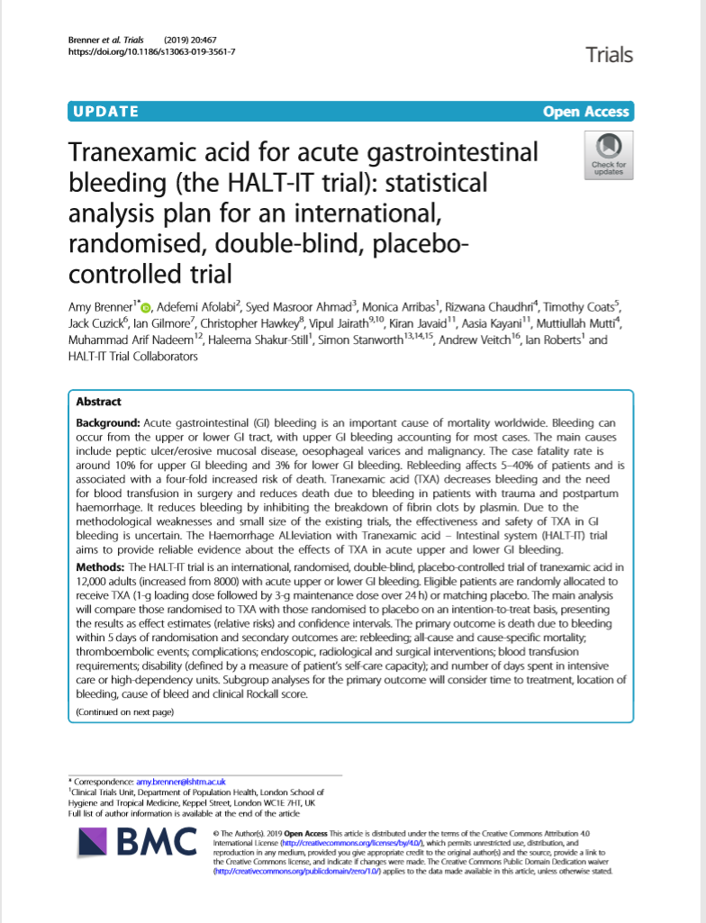
Statistical analysis plan

Slide 17
Statistical analysis plan
Primary outcome:
Death due to bleeding within 5 days of randomisation.
Secondary outcomes:
Re-bleeding within 24 h, 5 days and 28 days of randomisation.
Death due to bleeding within 28 days.
All-cause and cause-specific mortality within 28 days.
Diagnostic and therapeutic endoscopic and radiological procedures and surgical interventions.
Blood product transfusion.
Thromboembolic events (pulmonary embolism, deep vein thrombosis, stroke and myocardial infarction).
Other complications (renal, hepatic and respiratory failure, cardiac events, sepsis, pneumonia and seizures).
Self-care capacity.
Days spent in the intensive care or high-dependency unit.
Subgroup analyses for the primary outcome of death due to bleeding: time to treatment, location of bleeding, cause of bleeding and clinical Rockall score.

Slide 18
Death due to bleeding and re-bleeding
 | TXA |  | Placebo |  | RR (95% CI)
 | (n=5956) |  | (n=5981)
 | n | (%) | n | (%)
Death due to bleeding within 24 hours | 124 | (2.1) | 120 | (2.0) | 1.04 (0.81-1.33)
Death due to bleeding within 5 days | 222 | (3.7) | 226 | (3.8) | 0.99 (0.82-1.18)
Death due to bleeding within 28 days | 253 | (4.2) | 262 | (4.4) | 0.97 (0.82-1.15)
Rebleeding within 24 hours* | 41 | (0.7) | 41 | (0.7) | 1.00 (0.65-1.55)
Rebleeding within 5 days* | 287 | (4.8) | 315 | (5.3) | 0.91 (0.78-1.07)
Rebleeding within 28 days* | 410 | (6.8) | 448 | (7.5) | 0.92 (0.81-1.05)
*Excludes 13 patients missing data on rebleed status or rebleed date.
Death or rebleeding in-hospital during follow-up.
CI=confidence interval, RR=risk ratio, TXA=tranexamic acid

Slide 19
All causes of death
 | TXA |  | Placebo |  | RR (95% CI)
 | (N=5956) |  | (N=5981)
 | n | (%) | n | (%)
Bleeding | 253 | (4.2) | 262 | (4.4) | 0.97 (0.82-1.15)
Thromboembolic event | 26 | (0.4) | 17 | (0.3) | 1.54 (0.83-2.83)
Organ failure | 109 | (1.8) | 114 | (1.9) | 0.96 (0.74-1.25)
Pneumonia | 57 | (1.0) | 42 | (0.7) | 1.36 (0.92-2.03)
Sepsis | 33 | (0.6) | 49 | (0.8) | 0.68 (0.44-1.05)
Malignancy | 65 | (1.1) | 40 | (0.7) | 1.63 (1.10-2.42)
Other | 21 | (0.4) | 24 | (0.4) | 0.88 (0.49-1.58)
All cause | 564 | (9.5) | 548 | (9.2) | 1.03 (0.92-1.16)
Death in-hospital during follow-up.

Slide 20
Subgroup analysis – Time since onset

Slide 21
Subgroup analysis – Bleed location

Slide 22
Subgroup analysis – Liver disease

Slide 23
Subgroup analysis – Rockall score

Slide 24
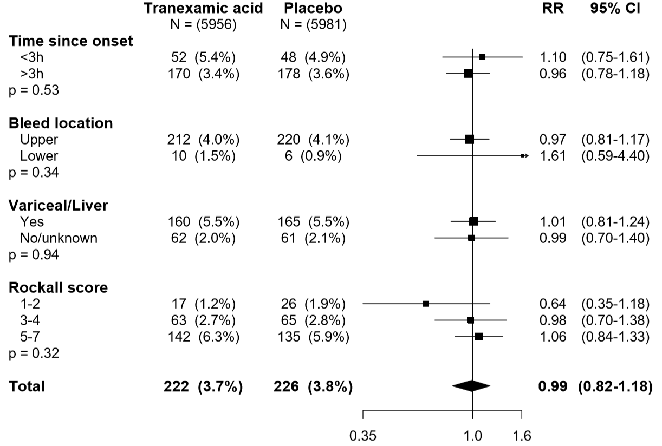
Subgroup analysis

Slide 25
Subgroup analysis
 | TXA (N=5956) |  |  | Placebo (N=5981) |  |  | RR (95% CI)
 | n | % | N | n | % | N
Time since onset
≤3h | 52 | 5.4% | 956 | 48 | 4.9% | 970 | 1.10 (0.75-1.61)
>3h | 170 | 3.4% | 5000 | 178 | 3.6% | 5010 | 0.96 (0.78-1.18)
(p=0.53)
Bleed location
Upper | 212 | 4.0% | 5285 | 220 | 4.1% | 5334 | 0.97 (0.81-1.17)
Lower | 10 | 1.5% | 671 | 6 | 0.9% | 647 | 1.61 (0.59-4.40)
(p=0.34)
Suspected variceal bleeding/liver disease
No/unknown | 62 | 2.0% | 3049 | 61 | 2.1% | 2968 | 0.99 (0.70-1.40)
Yes | 160 | 5.5% | 2907 | 165 | 5.5% | 3013 | 1.01 (0.81-1.24)
(p=0.94)
Rockall score
1-2 | 17 | 1.2% | 1412 | 26 | 1.9% | 1388 | 0.64 (0.35-1.18)
3-4 | 63 | 2.7% | 2291 | 65 | 2.8% | 2321 | 0.98 (0.70-1.38)
5-7 | 142 | 6.3% | 2253 | 135 | 5.9% | 2272 | 1.06 (0.84-1.33)
(p=0.32)

Slide 26
Diagnostic and therapeutic interventions
 | TXA |  |  |  | Placebo |  |  |  | RR (95% CI)
 | n |  | N | (%) | n |  | N | (%)
Diagnostic endoscopy | 4781 | / | 5953 | (80.3) | 4729 | / | 5978 | (79.1) | 1.02 (1.00-1.03)
Therapeutic endoscopy | 2542 | / | 5952 | (42.7) | 2658 | / | 5978 | (44.5) | 0.96 (0.92-1.00)
Diagnostic radiological procedure | 1704 | / | 5953 | (28.6) | 1744 | / | 5978 | (29.2) | 0.98 (0.93-1.04)
Therapeutic radiological procedure | 74 | / | 5953 | (1.2) | 89 | / | 5978 | (1.5) | 0.83 (0.61-1.13)
Surgical intervention | 146 | / | 5953 | (2.5) | 158 | / | 5978 | (2.6) | 0.93 (0.74-1.16)
Any surgical, endoscopic or radiological intervention | 5216 | / | 5956 | (87.6) | 5236 | / | 5981 | (87.5) | 1.00 (0.99-1.01)

Slide 27
Blood products transfusion
 | TXA |  |  |  | Placebo |  |  |  | RR (95% CI)
 | n |  | N | (%) | n |  | N | (%)
Any transfusion | 4076 | / | 5951 | (68.5) | 4129 | / | 5978 | (69.1) | 0.99 (0.97-1.02)
Whole blood/red cells | 3984 | / | 4076 | (97.7) | 4018 | / | 4129 | (97.3) | 1.00 (1.00-1.01)
Frozen plasma | 910 | / | 4076 | (22.3) | 993 | / | 4129 | (24.0) | 0.93 (0.86-1.00)
Any platelets | 219 | / | 4076 | (5.4) | 255 | / | 4129 | (6.2) | 0.87 (0.73-1.04)
Units | Mean |  | (SD) |  | Mean |  | (SD) |  | Difference in means (95% CI)
Whole blood/red cells | 2.8 |  | (2.4) |  | 2.9 |  | (2.7) |  | -0.06 (0.05, -0.18)
Frozen plasma | 0.9 |  | (2.4) |  | 1.0 |  | (2.6) |  | -0.05 (-0.01, -0.23)
Any platelets | 0.2 |  | (0.9) |  | 0.2 |  | (1.0) |  | -0.02 (0.02, -0.06)

Slide 28
Thromboembolic events
 | TXA |  |  |  | Placebo |  |  |  | RR (95% CI)
 | n |  | N | (%) | n |  | N | (%)
Any thromboembolic event | 86 | / | 5952 | (1.4) | 72 | / | 5977 | (1.2) | 1.20 (0.88-1.64)
Venous events (DVT, PE) | 48 | / | 5952 | (0.8) | 26 | / | 5977 | (0.4) | 1.85 (1.15-2.98)
DVT | 23 | / | 5952 | (0.4) | 12 | / | 5977 | (0.2) | 1.92 (0.96-3.86)
PE | 28 | / | 5952 | (0.5) | 16 | / | 5977 | (0.3) | 1.76 (0.95-3.24)
Arterial events (MI, stroke) | 42 | / | 5952 | (0.7) | 46 | / | 5977 | (0.8) | 0.92 (0.60-1.39)
MI | 24 | / | 5952 | (0.4) | 28 | / | 5977 | (0.5) | 0.86 (0.50-1.48)
Stroke | 19 | / | 5952 | (0.3) | 18 | / | 5977 | (0.3) | 1.06 (0.56-2.02)
CI = confidence interval, DVT = deep vein thrombosis, PE = pulmonary embolism, MI = myocardial infarction, RR = risk ratio, TXA = tranexamic acid

Slide 29
Complications and self-care capacity
 | TXA |  |  |  | Placebo |  |  |  | RR (95% CI)
 | n |  | N | (%) | n |  | N | (%)
Renal failure | 142 | / | 5951 | (2.4) | 157 | / | 5978 | (2.6) | 0.91 (0.73-1.14)
Liver failure | 196 | / | 5952 | (3.3) | 184 | / | 5977 | (3.1) | 1.07 (0.88-1.30)
Respiratory failure | 105 | / | 5952 | (1.8) | 131 | / | 5978 | (2.2) | 0.81 (0.62-1.04)
Cardiac event | 100 | / | 5952 | (1.7) | 89 | / | 5977 | (1.5) | 1.13 (0.85-1.50)
Sepsis | 210 | / | 5952 | (3.5) | 216 | / | 5977 | (3.6) | 0.98 (0.81-1.18)
Pneumonia | 193 | / | 5952 | (3.2) | 174 | / | 5978 | (2.9) | 1.11 (0.91-1.36)
Seizure | 38 | / | 5952 | (0.6) | 22 | / | 5977 | (0.4) | 1.73 (1.03-2.93)
 | Mean |  | (SD) |  | Mean |  | (SD) |  | Difference in means (95% CI)
Days in ICU | 0.4 |  | (1.8) |  | 0.4 |  | (2.0) |  | -0.06 (0.01, -0.13)
Katz score | 5.5 |  | (1.5) |  | 5.5 |  | (1.4) |  | -0.03 (0.02, -0.09)
ICU = Intensive Care Unit

Slide 30
Subgroup analyses – venous events
 |  | TXA |  |  |  | Placebo |  |  |  | RR (95% CI)
 |  | n |  | N | % | n |  | N | %
Suspected variceal bleeding / liver disease | No | 34 | / | 3047 | 1.1% | 24 | / | 2966 | 0.8% | 1.38 (0.82-2.32)
 | Yes | 14 | / | 2905 | 0.5% | 2 | / | 3011 | 0.1% | 7.26 (1.65-31.90)
(p=0.035)
Location of bleed | Upper | 39 | / | 5281 | 0.7% | 20 | / | 5310 | 0.4% | 1.97 (1.15-3.37)
(p=0.60) | Lower | 9 | / | 671 | 1.3% | 6 | / | 647 | 0.9% | 1.45 (0.52-4.04)
Age | <60 | 12 | / | 3128 | 0.4% | 5 | / | 3098 | 0.2% | 2.38 (0.84-6.74)
 | 60-79 | 26 | / | 2066 | 1.3% | 8 | / | 2114 | 0.4% | 3.33 (1.51-7.33)
(p=0.036) | 80+ | 10 | / | 758 | 1.3% | 13 | / | 765 | 1.7% | 0.78 (0.34-1.76)
Rockall score | 1-2 | 7 | / | 1412 | 0.5% | 6 | / | 1382 | 0.4% | 1.15 (0.39-3.40)
 | 3-4 | 18 | / | 2287 | 0.8% | 7 | / | 2313 | 0.3% | 2.61 (1.09-6.23)
(p=0.51) | 5-7 | 23 | / | 2253 | 1.0% | 13 | / | 2269 | 0.6% | 1.78 (0.90-3.51)
Time since injury | <=3h | 10 | / | 955 | 1.0% | 4 | / | 969 | 0.4% | 2.54 (0.80-8.06)
 | 3-8h | 10 | / | 1595 | 0.6% | 9 | / | 1540 | 0.6% | 1.07 (0.44-2.63)
(p=0.37) | >8h | 28 | / | 3402 | 0.8% | 13 | / | 3467 | 0.4% | 2.19 (1.14-4.23)

Slide 31
Current evidence on TXA in GI bleeding - death

Slide 32
Tranexamic acid did not reduce the deaths from GI bleeding
There was an increased risk of venous thromboembolic events and seizures in patients with GI bleeding
Tranexamic acid should not be used for the treatment of GI bleeding outside the context of a randomised trial.

Slide 33

Website: http://haltit.lshtm.ac.uk Twitter: @ctu_LSHTM

